Slide 1
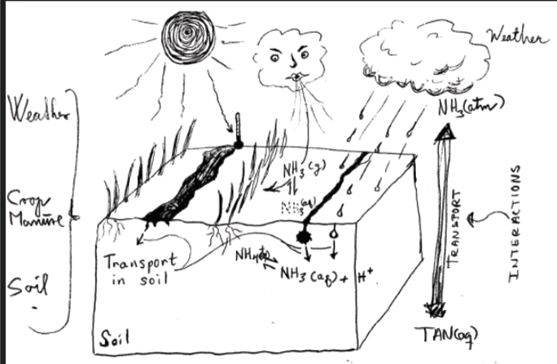
Let’s improve ammonia emission models for field-applied manure
Sommer S.G., Pedersen, J., Hafner S.D., , Pacholski A.

Slide 2
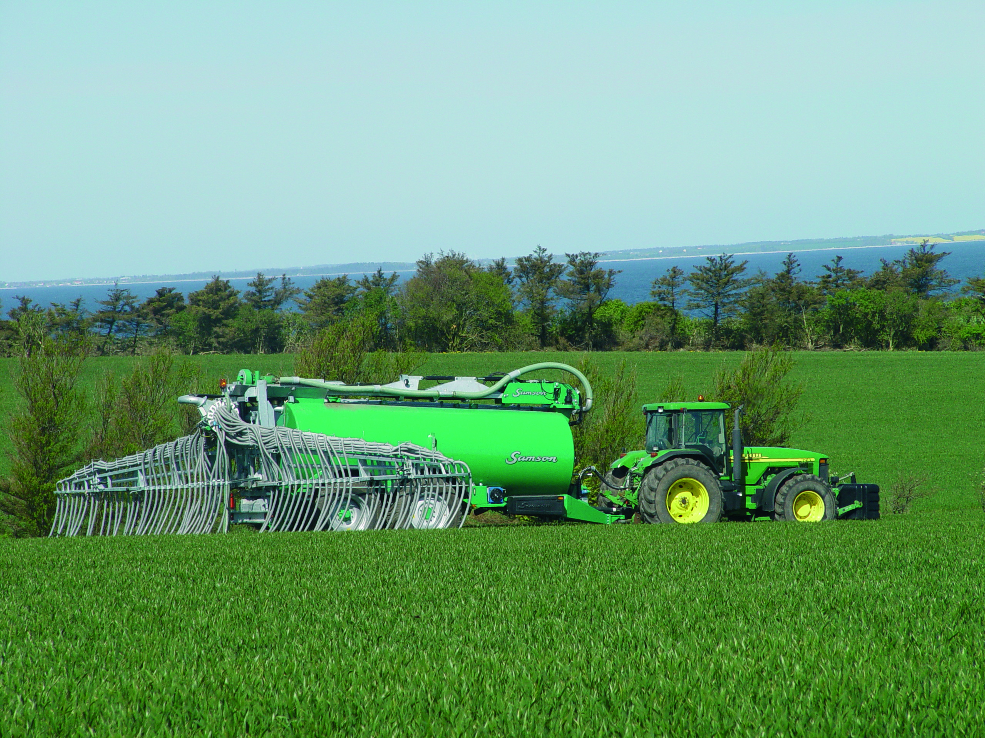
Background
Agronomist, PhD, Dr. Tech
Ministry of Environment & National Environmental Research Institute (NERI)
Danish Institute of Agricultural Sciences, University of Southern Denmark, Aarhus University
Sven Gjedde Sommer
Faculty of Technical Sciences (Tech).
Department of Biological and Chemical Engineering (BCE)
Research
Ammonia emission – animal manure
GHG emission – animal manure
Separation of animal manure
Sustainable manure management (Developing countries)

Slide 3
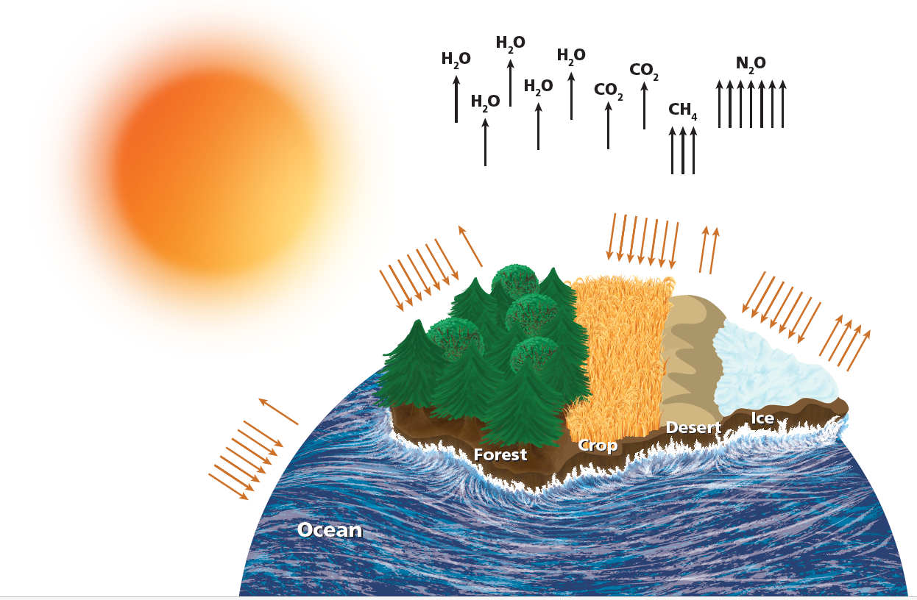
Activities
Editor: Bioprocesses: A Comprehensive Guide to Sustainable Resources in the Non-Fossil Era (Cambridge University Press)
Green Irrigation technology using salt water – Network with colleagues from India (Climate change adaptation)
Future potential activities
Hydrobiochar project –with Chinese partners –calculate GHG reduction
Ammonia emission from bird colonies in Chile
Accelerating implementation of sustainable manure nutrient recycling strategies and technologies workshop - Chile (OECD,)
Impact of competence building project SUSANE in Vietnam & new courses in Research-based public sector consultancy (GHG – climate change)

Slide 4
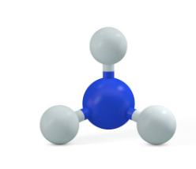
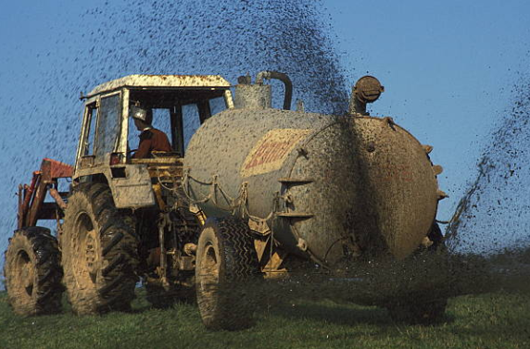
Do we know: the relevant processes? the rate parameters?
Can we can create a good predictive model?
→
Do we have a good enough understanding of the system?
Notes:
Mention semi-empirical ALFAM and process based model (Volt’air) and black box models (EF)

Slide 5
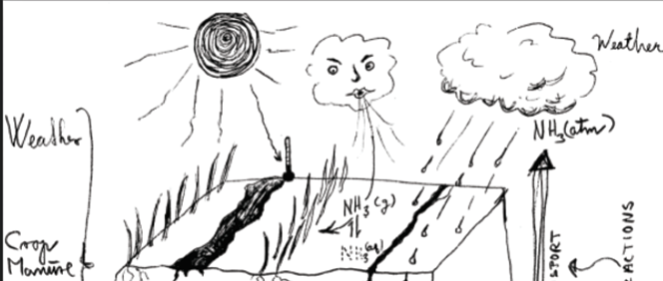
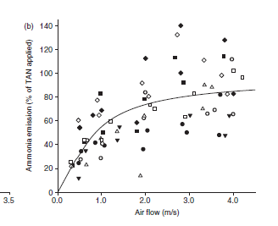
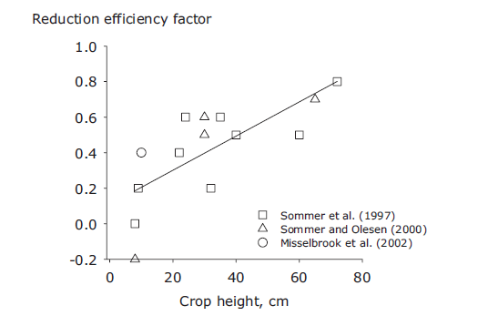
Transport in air
Nice models building on resistance to transport – are not used in farm models or inventory calculators
ALFAM2 model (Hafner et al. 2018/2019)
include wind effect (High SD) - no effect of crop height?
Proposal:
Air transport calculations can be improved by use of the resistance to transport concept.
Can we use the resistance concept to include crop effect?
Is emission exponentially related to wind speed (Wind tunnel)?
Is reduction in emission linearly related to crop height (IHF)?
(Sommer and Misselbrook 2016; Thorman et al. 2008)
Notes:
The ALFAM2 model include wind effect – not very precise yet
Considering resistances to transport and transfer, then at increasing wind speed/turbulence then resistance in the air phase will be low compared to restance to release from the slurry/soil liquid phase and then increasing wind speed will no longer increase emission much (if not considering interactions ☹)

Slide 6
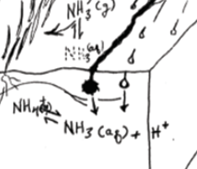
Ammonium – Ammonia-Equilibrium
Temperature dependence
Surface temperature can be much different from air temperature.
- Difference: Depends on solar radiation, albedo, wind and canopy cover.
-Take care: reported soil temperature is often taken below surface.
Proposal:
Surface temperature: estimated using incident solar radiation, albedo, wind and crop cover.
Measure soil surface temperature – 50€.
Notes:
A temperature logger was placed on the soil surface and air temperature measured at 2 m– under Danish conditions.
Soil surface temperature may be much higher during day time with clear sky than air temperature (May I bring your attention to that NH3 equilibrium is exponential related to temperature) Most studies carried out when weather is fine and none are measuring soil surface temperature.

Slide 7
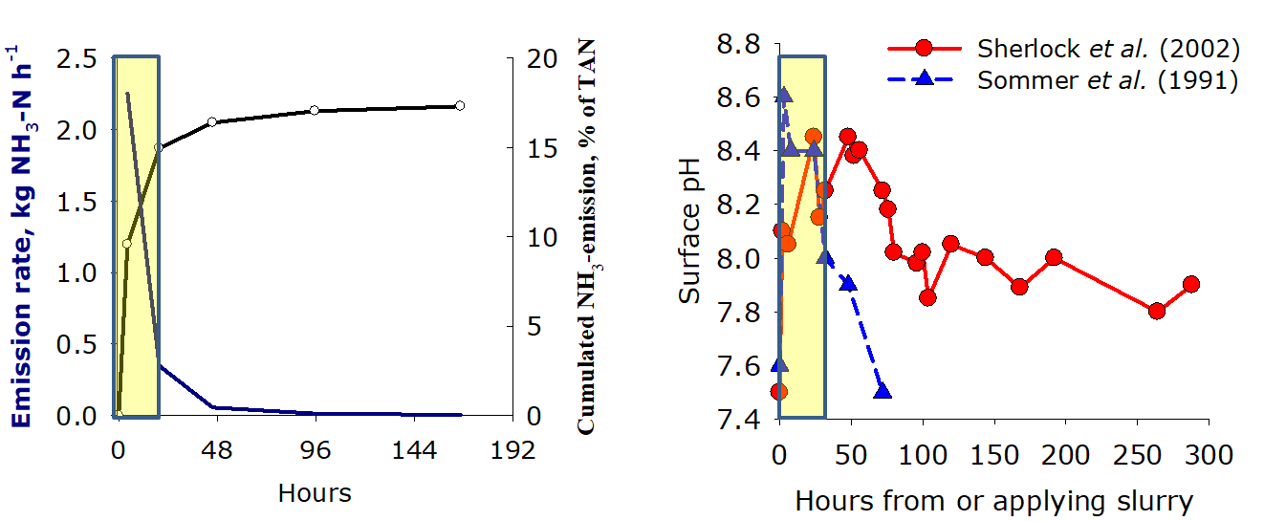
H⁺(aq) activity (pH) affects NH₃/NH₄⁺ equilibrium in the slurry/soil surface
Is too difficult, so let us forget it????
So
Few studies include pH??
Challenge
pH in slurry/soil surface measured with pH-electrodes (flat nose + water) ups?
Proposal
You could use optodes!
Include calculation about how CO₂ affect pH and emission?
Notes:
Measuring soil-pH is difficutl. E.g., there are two conventional methods: one where soil is mixed with water and one where it is mixed with a buffer solution – but, new optode work (I can find the paper if you want) show that none of them give the same value as the pH optodes (which they assume to be correct).
We know that CO2 emission increase slurry/Soil surface pH.

Slide 8
Temperature and crust interaction
Pedersen et al. (2021) emission increase with air temperature up to ca. 14 ºC. Assumed crust formation then halted emission (bare soil).
The crust effect:
Proposed after a visual observation by Thompson et al. (1990). No study confirm the hypothesis.
Proposal:
It is time to carry out studies of the effect of crust formation

Slide 9
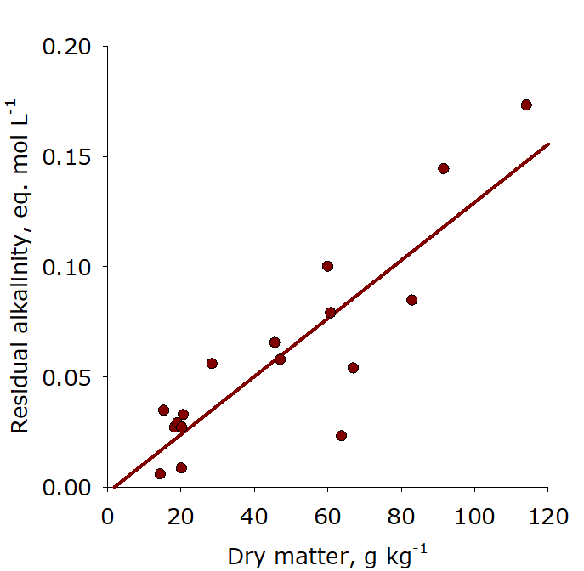
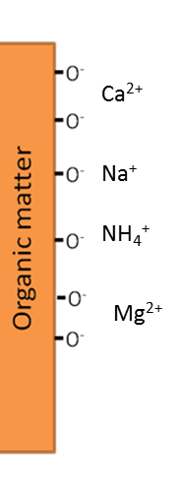
Crust – related to dry matter?
Crusts reduce emisison?
In contrast, NH₃ emission increases with DM??
&
DM contribute to negative charges - CEC
Proposal
Studies needed:
Absorption of NH₄⁺ to DM⁻ contribution to reduce mission?
Infiltration see next slide ☺
Sommer and Husted 1995. & Misselbrook and Powell 2005.
Notes:
Now I am getting confused and look forward to retire – DM, CEC, Crust???
The effect slurry DM was proved in a study from the 1990’ies.
Now ALFAM model calculations provide additional validation of this effect

Slide 10
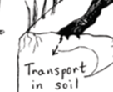
Infiltration
DM matter effects:
Viscosity of untreated slurry related to DM
Increase water retention in slurry/soil surface layer
Seal soil surface.
Soil
Texture
Porosity
Water content
Non Digestate slurries
Proposal
How can we measure this?
Maybe optodes can contribute to infiltration studies?
Thygesen, Triolo and Sommer, 2012)

Slide 11
Novel ALFAM2 model no effect of soil characteristic
Soil characteristics:
CEC
pH buffer
Lime
Proposal
How can we measure this?
Maybe optodes can contribute to infiltration studies?
Thygesen, Triolo and Sommer, 2012)

Slide 12
Rain
We know that rain affects emission
But what matters: intensity (mm / hour) or total amount (mm)
Few studies (known to us): More than 30 mm during short time is needed to affect emission (Beauchamp et al. 1982; Cobain et al. 2019)
ALFAM2 (Hafner et al. 2018/2029 ): No clear rain effect?
Proposal
Need to know effect of intensity vs. total rain amounts during emission events
Controlled experiments with measure of TAN transport (TIC)
Convective transport upwards in soil, after rain events.
Notes:
Rain effects may be even more complex to asses than pH effects ☺

Slide 13
This can measured or recorded without cost or at low cost
Soil: bare or covered with crops (size of crop at initiation and finalization)
Soil water content (Wet or dry - water content measured by drying)
Soil surface temperature
Solar radiation (Qualitative: cloudy or bright sunshine)
Surface pH

Slide 14
Summing up a little bit
Basic research about processes needed to bring us to the next and more precise level of calculating emission
We need methods to understand pH, infiltration, DM effects, wind – crop, ???
We must implement this knowledge in Farm models and Inventory calculators

Slide 15
GOBSAT
Good Old Boys Sit Around Table
?
Thank you for listening
After 40 years ?
Emission factors: percent of total N (Anonymous 1984)
Emissions factors: kg ammoniacal nitrogen (NH₃-N) per animal and year (Buijsman et al. (1987)
Emission factor: A percentage of N (ECETOC, 1994; Hutchings et al. 2001).
Emission factor: A percentage of TAN (NH₃+NH₄⁺) (Hansen et al. 2008: Webb et al. 2014, Sommer et al. 2019)
Notes:
Anonymous 1984. Kilder til NPO-belastning (N, P and Organic matter sources to the environment). In NPO-redegørelse. Miljøstyrelsen, DK-Copenhagen. pp 35-82.
Buijsman E., Maas H.F.M. and Asman W.A.H. 1987: Anthropogenic NH3 emissions in Europe. Atmos. Environ. 21, 1009-1022
ECETOC. 1994. Ammonia emissions to air in Western Europe, Technical Report No. 62.” European Centre for Ecotoxicology and Toxicology of Chemicals, Brussels, Belgium. Pp 196.
Hansen M.N., Sommer S.G., Hutchings N.J. and Sørensen P. 2008. Emissionsfaktorer til beregning af ammoniakfordampning ved lagring og udbringning af husdyrgødning (Emissions factors for calculation of ammonia volatilization by storage and application of animal manure. DJF Husdyrbrug nr. 84, December 2008. Tjele. Pp 28
Webb J. , Thorman R.E., Fernanda-Aller M., Jackson D.R. 2014. Emission factors for ammonia and nitrous oxide emissions following immediate manure incorporation on two contrasting soil types. Atmospheric Environment 82 (2014) 280e287
Sommer S.G., Webb J. and Hutchings N.D. 2019. New Emission Factors for Calculation of Ammonia Volatilization From European Livestock Manure Management Systems. Front. Sustain. Food Syst. 3:101. 1-9. doi: 10.3389/fsufs.2019.00101

Slide 16
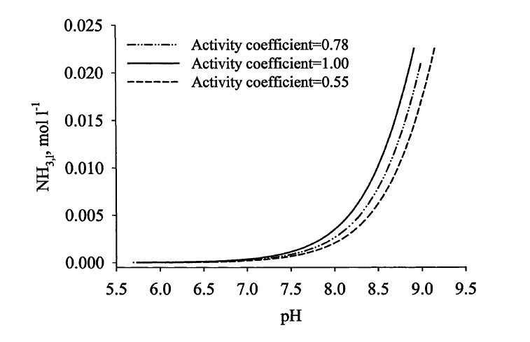
TAN in liquid surface processes
What about activity of the ions?
Contribute to
Ionic strength is related to Electric Conductivity (contribute
Notes:
SDH: Maybe this could be cut

Slide 17
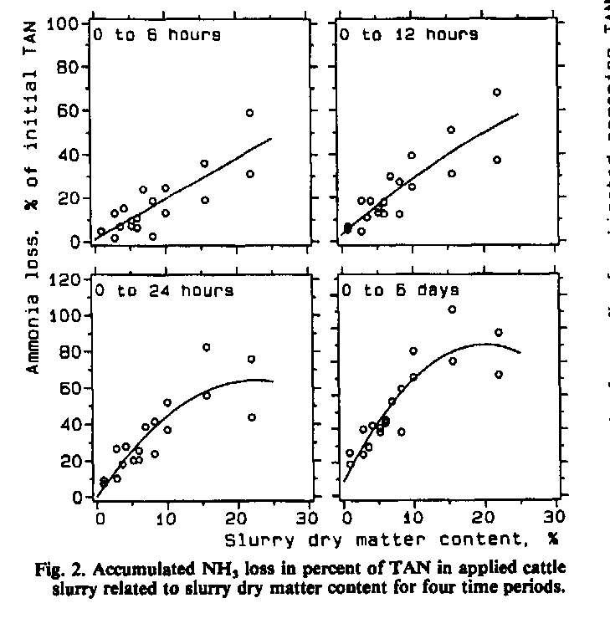

Slide 18
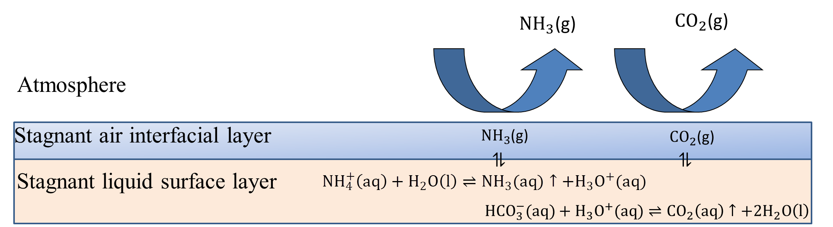
Ammonium is not emitted –
H⁺(aq) is much involved in controlling release of NH₃

